Slide 1

RSHE (Relationships, Sex and Health Education) from September 2020.
Information for Parents/carers
As you go through the slides there is a speaker on some pages to click for a voiceover. Thank you.

Slide 2
School and home partnership
We aim to inform you of:
the school’s legal obligations on Relationships and Sex Education (from 2020)
your rights as a parent/carer
how, what, why and when we intend to teach children and an overview of objectives covered for each year group

Slide 3
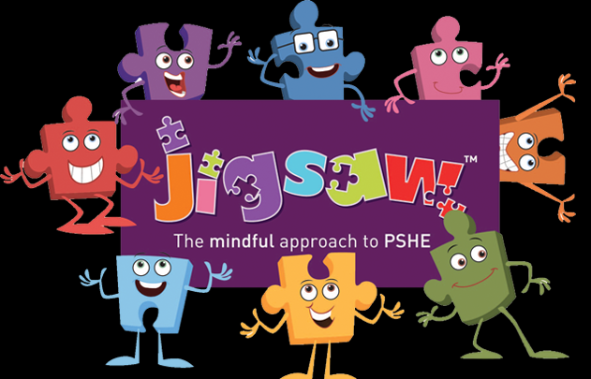
At Oswald Road, we teach 1 PSHE lesson per week, lasting 45 minutes – 1 hour. The scheme we follow is Jigsaw. This is split into 6 units:
Autumn 1 – Being Me
Autumn 2 – Celebrating Differences
Spring 1 – Dreams and Goals
Spring 2 – Healthy me
Our RSE units are taught in the Summer term.
These are:
Summer 1 - Relationships
Summer 2 - Changing Me

Slide 4

Compulsory status of RSE and Health Education
In 2017 the government passed an amendment to the Children and Social Work Bill to make RSE and Health Education statutory from Sept 2020.
Supported by over 100 organisations, including Public Health England, Teaching Unions, NCB, etc)
Ratified by House of Lords 24 April 2019
Our school scheme of work, Jigsaw meets all the expectations of the DfE guidance (published April 2019)

Slide 5
After September 2020,
Legally:
Schools MUST teach the Science curriculum
The DfE guidance 2019 states that Relationships and Health Education (including changing adolescent body) are compulsory
Plus…
a ‘recommendation’ that all schools have a Sex Education Programme
How schools do this is left up to them.

Slide 6
What have schools got to teach?
In Primary Schools:
Relationships Education is compulsory
Health Education is complulsory
But Sex Education is at school’s discretion

Slide 7


Relationships | Health (Some taught in previous units in the year)
Families and people who care for me Caring friendships Respectful relationships Online relationships Being safe | Mental wellbeing Internet safety and harms Physical health and fitness Healthy eating Drugs, alcohol and tobacco Health and prevention Basic First Aid Changing adolescent body (Puberty)

Slide 8
LGBTQ Equality - What the DfE RSHE guidance says:
‘Schools are required to comply with relevant requirements of the Equality Act 2010. Further guidance is available for schools in The Equality Act 2010 and schools advice. Schools should pay particular attention to the Public sector equality duty (PSED) (s.149 of the Equality Act).’ - Para 27 page 13
‘Schools should be alive to issues such as everyday sexism, misogyny, homophobia and gender stereotypes and take positive action to build a culture where these are not tolerated, and any occurrences are identified and tackled.’ - Para 31 page 13

Slide 9
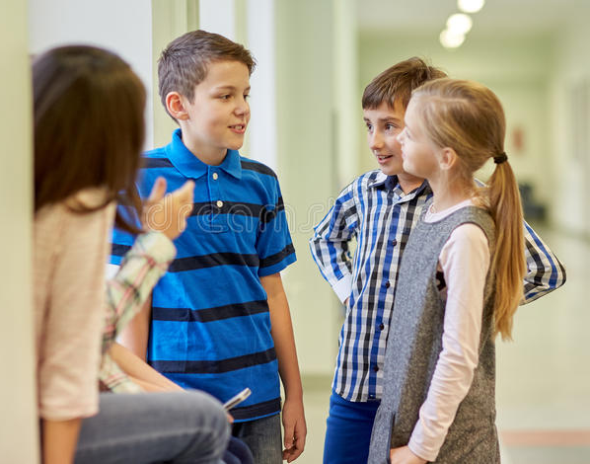

Today’s considerations:
The internet
Television
Social media
Other media
Friends
Family
School

Slide 10
Be aware:
We are educating children and young people
to live in the real world, with all its contradictions.
When it comes to sex, children’s heads are probably not empty – but they may be full of myths and half-truths.
We mustn’t let our adult knowledge of relationships and sex prevent us seeing things from a child’s perspective.
Our focus should be on building healthy attitudes and positive relationships.

Slide 11
“Parents have the right to request that their child be withdrawn from some or all of sex education delivered as part of statutory RSE”.
NOT from Relationships or Health Education.
We define Sex Education as…
Human reproduction…
Conception and birth
The following 2 slides show the objecives covered around Puberty and Human Reproduction in our Jigsaw curriculum. The lessons highlighted in yellow are the only lessons that children can be opted out of.

Slide 12
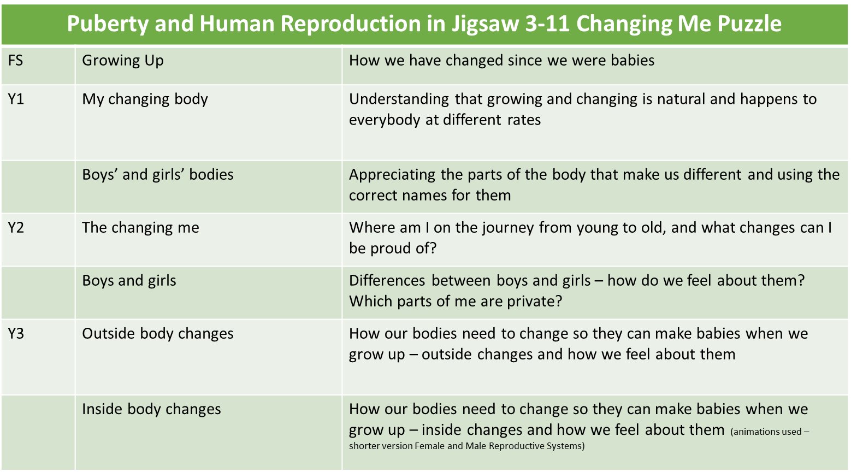

Slide 13
Puberty and Human Reproduction in Jigsaw 3-11 Changing Me Puzzle
Y4 | Having a baby | The choice to have a baby, the parts of men and women that make babies and – in simple terms – how this happens (animations used – the Female Reproductive System)
 | Girls and puberty | How a girl’s body changes so that she can have a baby when she’s an adult – including menstruation (animations used – the Female Reproductive System)
Y5 | Puberty for girls | Physical changes and feelings about them – importance of looking after yourself (animations used – the Female Reproductive System)
 | Puberty for boys | Developing understanding of changes for both sexes – reassurance and exploring feelings (animations used – the Male Reproductive System)
 | Conception | Understanding the place of sexual intercourse in a relationship and how it can lead to conception and the wonder of a new life (animations used – the Female and Male Reproductive Systems)
Y6 | Puberty | Consolidating understanding of physical and emotional changes and how they affect us (animations used – the Female and Male Reproductive Systems)
 | Girl talk / boy talk | A chance to ask questions and reflect (single sex) (animations used – the Female and Male Reproductive Systems)
 | Conception to birth | The story of pregnancy and birth (animations used – the Female and Male Reproductive Systems)

Slide 14
Objectives covered in Summer Term for each year group.

Slide 15
Nursery

Slide 16
Relationships
I can tell you about my family.
I understand how to make friends if I feel lonely.
I can tell you some of the things I like about my friends.
I know what to say and do if somebody is mean to me.
I can use Calm Me time to manage my feelings.
I can work together and enjoy being with my friends.

Slide 17
Changing me
I can name parts of my body and show respect for myself.
I can tell you some things I can do and some food. I can eat to be healthy.
I understand that we all start as babies and grow into children and then adults.
I know that I grow and change.
I can talk about how I feel moving to School from Nursery.
I can remember some fun things about Nursery this year.

Slide 18
Reception

Slide 19
Relationships
I can identify some of the jobs I do in my family and how I feel like I belong.
I know how to make friends to stop myself from feeling lonely.
I can think of ways to solve problems and stay friends.
I am starting to understand the impact of unkind words.
I can use Calm Me time to manage my feelings.
I know how to be a good friend.

Slide 20
Changing me
I can name parts of the body.
I can tell you some things I can do and foods I can eat to be healthy.
I understand that we all grow from babies to adults.
I can express how I feel about moving to Year 1.
I can talk about my worries and/or the things I am looking forward to about being in Year 1
I can share my memories of the best bits of this year in Reception.

Slide 21
Year 1

Slide 22
Relationships
I can identify the members of my family and understand that there are lots of different types of families.
I can identify what being a good friend means to me.
I know appropriate ways of physical contact to greet my friends and know which ways I prefer.
I know who can help me in my school community.
I can recognise my qualities as person and a friend.
I can tell you why I appreciate someone who is special to me.

Slide 23
Changing me
I am starting to understand the life cycles of animals and humans.
I can tell you some things about me that have changed and some things about me that have stayed the same.
I can tell you how my body has changed since I was a baby.
I can identify the parts of the body that make boys different to girls and can use the correct names for these: penis, testicles, vagina.
I understand that every time I learn something new I change a little bit.
I can tell you about changes that have happened in my life.

Slide 24
Year 2

Slide 25
Relationships
I can identify the different members of my family, understand my relationship with each of them and know why it is important to share and cooperate.
I understand that there are lots of forms of physical contact within a family and that some of this is acceptable and some is not.
I can identify some of the things that cause conflict with my friends.
I understand that sometimes it is good to keep a secret and sometimes it is not good to keep a secret.
I recognise and appreciate people who can help me in my family, my school and my community.
I can express my appreciation for the people in my special relationships.

Slide 26
Changing me
I can recognise cycles of life in nature.
I can tell you about the natural process of growing from young to old and understand that this is not in my control.
I can recognise how my body has changed since I was a baby and where I am on the continuum from young to old.
I can recognise the physical differences between boys and girls, use the correct names for parts of the body (penis, testicles, vagina) and appreciate that some parts of my body are private.
I understand there are different types of touch and can tell you which ones I like and don’t like.
I can identify what I am looking forward to when I am in Year 3.

Slide 27
Year 3

Slide 28
Relationships
I can identify the roles and responsibilities of each member of my family and can reflect on the expectations for males and females.
I can identify and put into practice some of the skills of friendship, e.g. taking turns, being a good listener.
I know and can use some strategies for keeping myself safe.
I can explain how some of the actions and work of people around the world help and influence my life.
I understand how my needs and rights are shared by children around the world and can identify how our lives may be different.
I know how to express my appreciation to my friends and family.

Slide 29
Changing me
I understand that in animals and humans lots of changes happen between conception and growing up, and that usually it is the female who has the baby.
I understand how babies grow and develop in the mother’s uterus I understand what a baby needs to live and grow.
I understand that boys’ and girls’ bodies need to change so that when they grow up their bodies can make babies I can identify how boys’ and girls’ bodies change on the outside during this growing up process.
I can identify how boys’ and girls’ bodies change on the inside during the growing up process and can tell you why these changes are necessary so that their bodies can make babies when they grow up.
I can start to recognise stereotypical ideas I might have about parenting and family roles.
I can identify what I am looking forward to when I am in Year 4.

Slide 30
Year 4

Slide 31
Relationships
I can recognise situations that can cause jealousy.
I can identify someone I love and can express why they are special to me.
I can tell you about someone I know that I no longer see.
I can recognise how friendships change, know how to make new friends and how to manage when I fall out with my friends.
I understand what having a boyfriend/girlfriend might mean and that it is a special relationship for when I am older.
I know how to show love and appreciation to the people and animals who are special to me.

Slide 32
I understand that some of my personal characteristics have come from my birth parents and that this happens because I am made from the joining of their egg and sperm.
Changing me
I understand that some of my personal characteristics have come from my birth parents and that this happens because I am made from the joining of their egg and sperm.

Slide 33
I can correctly label the internal and external parts of male and female bodies that are necessary for making a baby.
Example script for lesson:
It’s amazing how a baby starts to grow when a man’s sperm and a woman’s ovum meet and join together. This can happen when a grownup man and woman share an especially close and loving embrace which allows the sperm to be released through the penis into the vagina. People refer to this as ‘making love’ or ‘having sex’ or sexual intercourse (children will probably have heard these expressions before, but may not really understand what sexual intercourse really means) It’s an intimate, loving and very private part of a grown-up relationship. From the vagina, the sperm can swim through the womb/
uterus into the tubes that lead from the ovaries. If they meet an egg/ovum there, one of them may ‘fertilise’ it - join with it so that it starts growing into a baby. This is called conception. The fertilised egg settles into the soft lining of the mother’s womb, where it will grow until it is big enough to be born 40 weeks/(9 months). The baby will get half of its genes from the mother’s egg/ovum and half its genes from the father’s sperm.

Slide 34
I can describe how a girl’s body changes in order for her to be able to have babies when she is an adult, and that menstruation (having periods) is a natural part of this.
Example script for lesson:
When a girl’s body reaches puberty the eggs (ova) in her ovaries start to mature. Puberty can happen any time between the ages of 10 and 14, but it is different for everyone so we shouldn’t worry if we start puberty earlier or later than our friends.
• Once a month, one of the tiny eggs (ova) stored in the woman’s ovaries is released. It passes into the fallopian tube and then into the womb/ uterus.
• If the egg (ovum) meets a man’s sperm at this point, the egg will be fertilised and a baby will start to grow. This is called conception.
• Every month the womb/ uterus makes a thick, soft, spongy lining with an extra supply of blood to provide all the nutrients that a baby would need.
• If an egg is fertilised it settles into this soft lining of the womb/uterus and develops into a baby.
• If an egg (ovum) isn’t fertilised by a sperm, then the lining of the womb isn’t needed. The lining breaks up and the spare blood it
contains passes out of the woman’s body through her vagina and vulva. This is what is called ‘having a period’.
•Unlike when we cut ourselves, this flow of blood is normal and natural for a girl who has reached puberty. It shows that the girl’s/
woman’s body is working as it should.
• Girls and women need to soak up the blood (menstrual flow) as it comes out of the vagina/vulva. They can use an absorbent towel
which they wear in their underwear, or a tampon which they insert into the vagina. It is important that these are changed regularly.
• The amount of blood leaving the body varies from woman to woman, but on average it’s about two tablespoons worth, or enough to fill an egg cup. Most women have periods once a month until they are in their fifties when they gradually stop.

Slide 35
I know how the circle of change works and can apply it to changes I want to make in my life.
I can identify changes that have been and may continue to be outside of my control that I learnt to accept.
I can identify what I am looking forward to when I am in Year 5.

Slide 36
Year 5

Slide 37
Relationships
I have an accurate picture of who I am as a person in terms of my characteristics and personal qualities.
I understand that belonging to an online community can have positive and negative consequences.
I understand there are rights and responsibilities in an online community or social network.
I know there are rights and responsibilities when playing a game online.
I can recognise when I am spending too much time using devices (screen time).
I can explain how to stay safe when using technology to communicate with my friends.

Slide 38
Changing me
I am aware of my own self-image and how my body image fits into that.

Slide 39
I can explain how a girl’s body changes during puberty and understand the importance of looking after yourself physically and emotionally.
Script example from lesson:
When a girl’s body reaches puberty the eggs (ova) in her ovaries start to mature. Puberty can happen any time between the ages of 10 and 14, but it is different for everyone so we shouldn’t worry if we start puberty earlier or later than our friends. • A female’s reproductive system has five main parts (refer to the animation). The vulva isn’t labelled in the animation, but that is the name for the outside parts of a woman’s private parts (genitals). • Once a month, the woman’s oestrogen levels rise in her ovaries and one of the tiny eggs (ova) stored there is released. It passes into the fallopian tube and then into the womb/ uterus. Oestrogen is a hormone (chemical) in the woman’s ovaries. The oestrogen also causes the womb/uterus lining to thicken getting it ready with an extra supply of blood in case the woman becomes pregnant with a baby. • If sexual intercourse happens between a man and a woman, the man’s sperm is released into the woman’s vagina and they travel up through the cervix. (At this point you can explain that having a baby is a choice, and that some people choose to have protected sex and to stop the sperm and egg from meeting. You don’t need to go into details about contraception, but simply say there are different ways that protected sex can happen and they will learn about this when they are older and ready for this information). Can you remember the facts about menstruation? Do you know what sanitary products look like and how they are used? What questions or worries do you think girls a bit younger than you might have when they think about puberty? • If the egg (ovum) meets a sperm, the egg will be fertilised and a baby will start to grow. This is called conception. The baby at this point is called an embryo. • If an egg is fertilised it settles into this soft lining of the womb/uterus and the embryo develops into a baby. • If an egg (ovum) isn’t fertilised by a sperm, then the lining of the womb isn’t needed. The lining breaks up and the spare blood it contains passes out of the woman’s body through her vagina and vulva. This is what is called ‘having a period’. • Unlike when we cut ourselves, this flow of blood is normal and natural for a girl who has reached puberty. It shows that the girl’s/ woman’s body is working as it should. • The same cycle (the menstrual cycle) repeats itself once a month. The exact number of days between periods is different for every woman, but it is usually between 21 and 35 days. • Girls and women need to soak up the blood (menstrual flow) as it comes out of the vagina/vulva. They can use an absorbent towel which they wear in their underwear, or a tampon which they insert into the vagina. It is important that these are changed regularly. • The amount of blood leaving the body varies from woman to woman, but on average it’s about two tablespoons worth, or enough to fill an egg cup. Most women have periods once a month until they are in their fifties when they gradually stop.

Slide 40
I can describe how boys’ and girls’ bodies change during puberty.
Example script from lesson:
When a boy reaches puberty, his testicles start making more of a hormone called testosterone. This hormone is responsible for the changes to the boy’s body at puberty. Puberty usually starts around the age of 12, but for some boys it can be earlier and for some much later. Whatever is the right time for that boy’s body. • At puberty the boy’s testicles grow in size and start making sperm. The boy’s penis may also get bigger. Body changes on the outside include growing facial hair, and thicker hair (pubic) on the body (under the arms, around the testicles), and sometimes on the chest, arms and legs. Boys may also get taller; their voice will get deeper because of changes in their Adam’s apple (larynx) and they will become more muscular. Like the rest of puberty, these changes are individual, and not all boys develop in the same way at the same time, so we should try not to compare ourselves with what is happening to friends. • The boy’s sexual organs have 5 main parts (refer to the animation). It may also be helpful here to explain that the animation shows a circumcised penis (where the foreskin has been removed for medical or other reasons), and some boys have a circumcised penis. Other boys still have the foreskin which means the top part of the penis isn’t so visible. Emphasise that whatever is normal for them, is normal for them. It is also worth saying that there is no such thing as an ‘average sized’ penis. Every man’s is different. Can you identify the correct words to describe changes that happen to boys during puberty? • The boy’s testes are held in bags of skin called the scrotum. Inside the testes there are many tiny tubes which make the sperm. At puberty the testes start to make millions of sperm every day. These sperm carry the messages (genes) about his characteristics and are necessary to fertilise an egg to create a baby. • The sperm are stored in the epididymis. When a man becomes sexually excited the spongy tissue inside his penis fills with blood and it becomes erect (stiff). This happens so the penis can enter the vagina during sexual intercourse. • When having sexual intercourse (making love) the sperm are mixed with a special fluid called semen that give the sperm energy and keep them healthy. The semen containing the sperm then passes out of the penis which is called an ejaculation. • It is quite normal for boys and men to get ‘wet dreams’ at night where a tiny amount of the sperm and semen stored in the epididymis leaks out. This can also be another sign that puberty has started and is nothing to worry about. • During sexual intercourse, the sperm enter the woman’s vagina and swim to meet the egg to create a baby. As discussed last time, people can choose to have sex so that the sperm and egg don’t meet, this is called protected sex and there are different ways this can happen, which you will learn about when you are ready to know about this.

Slide 41
I understand that sexual intercourse can lead to conception and that is how babies are usually made I also understand that sometimes people need IVF to help them have a baby.
I can identify what I am looking forward to about becoming a teenager and understand this brings growing responsibilities (age of consent).
I can identify what I am looking forward to when I am in Year 6.

Slide 42
Year 6

Slide 43
Relationships
I know that it is important to take care of my mental health.
“Mental health is a state of wellbeing in which the individual realises his or her own abilities, can cope with the normal stresses of life, can work productively and fruitfully and is able to make a contribution to his or her own community.”
I know how to take care of my mental health.
I understand that there are different stages of grief and that there are different types of loss that cause people to grieve.
I can recognise when people are trying to gain power or control.
I can judge whether something online is safe and helpful for me.
I can use technology positively and safely to communicate with my friends and family.

Slide 44
S Stay safe by not posting or sharing private information or pictures
M Meeting someone you have met online can be dangerous. It is best not to do this at all but if you must,
take a parent or carer with you.
A Accepting messages and emails or opening files, pictures or links sent by someone you don’t know can be
risky. They might contain viruses or have nasty messages or images meant to upset you.
R Reliable information is important. People online can be whoever they want to be and say whatever they like. Many things on the internet are fake. Check things out to make sure they are true or real by asking an adult
you trust. If you like chatting online only do this with friends and family who you know in REAL life, and use
your privacy settings.
R Rights and Responsibilities. Remember we have the right to be treated with respect online and we have a
responsibility we do the same for others. If you are going to be unkind to someone online (because you feel
you want to, or because others are encouraging you to), stop and think if this is the right thing to do.
T Tell a trusted adult if something online is worrying you or a friend. If something makes you feel uncomfortable
online, listen to your conscience and tell someone. Also speak out if there is bullying happening online to you
or someone you know.

Slide 45
Changing me
I am aware of my own self-image and how my body image fits into that.
I can explain how girls’ and boys’ bodies change during puberty and understand the importance of looking after yourself physically and emotionally.
I can describe how a baby develops from conception through the nine months of pregnancy, and how it is born.
I understand how being physically attracted to someone changes the nature of the relationship and what that might mean about having a girlfriend/boyfriend.
I am aware of the importance of a positive self-esteem and what I can do to develop it.
I can identify what I am looking forward to and what worries me about the transition to secondary school.

Slide 46
Examples of materials used……

Slide 47
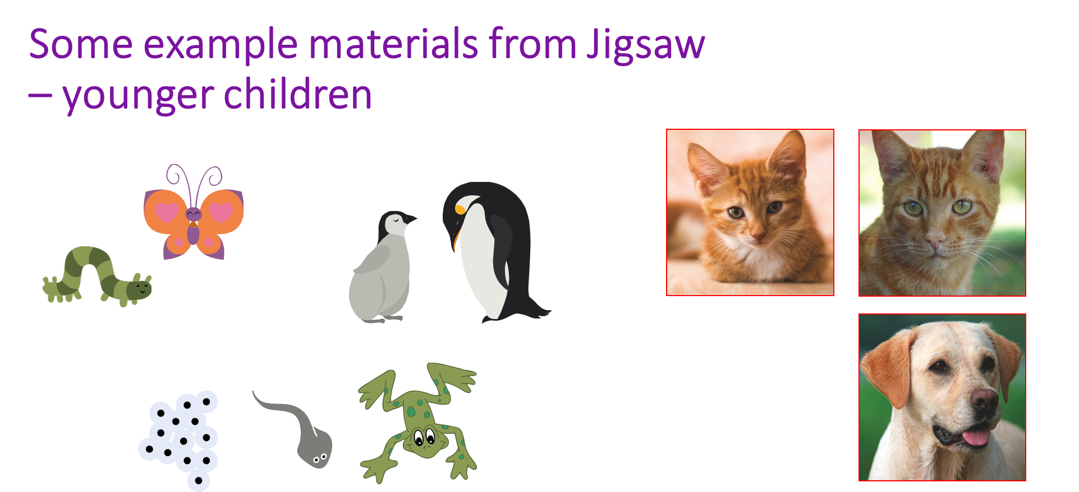

Slide 48
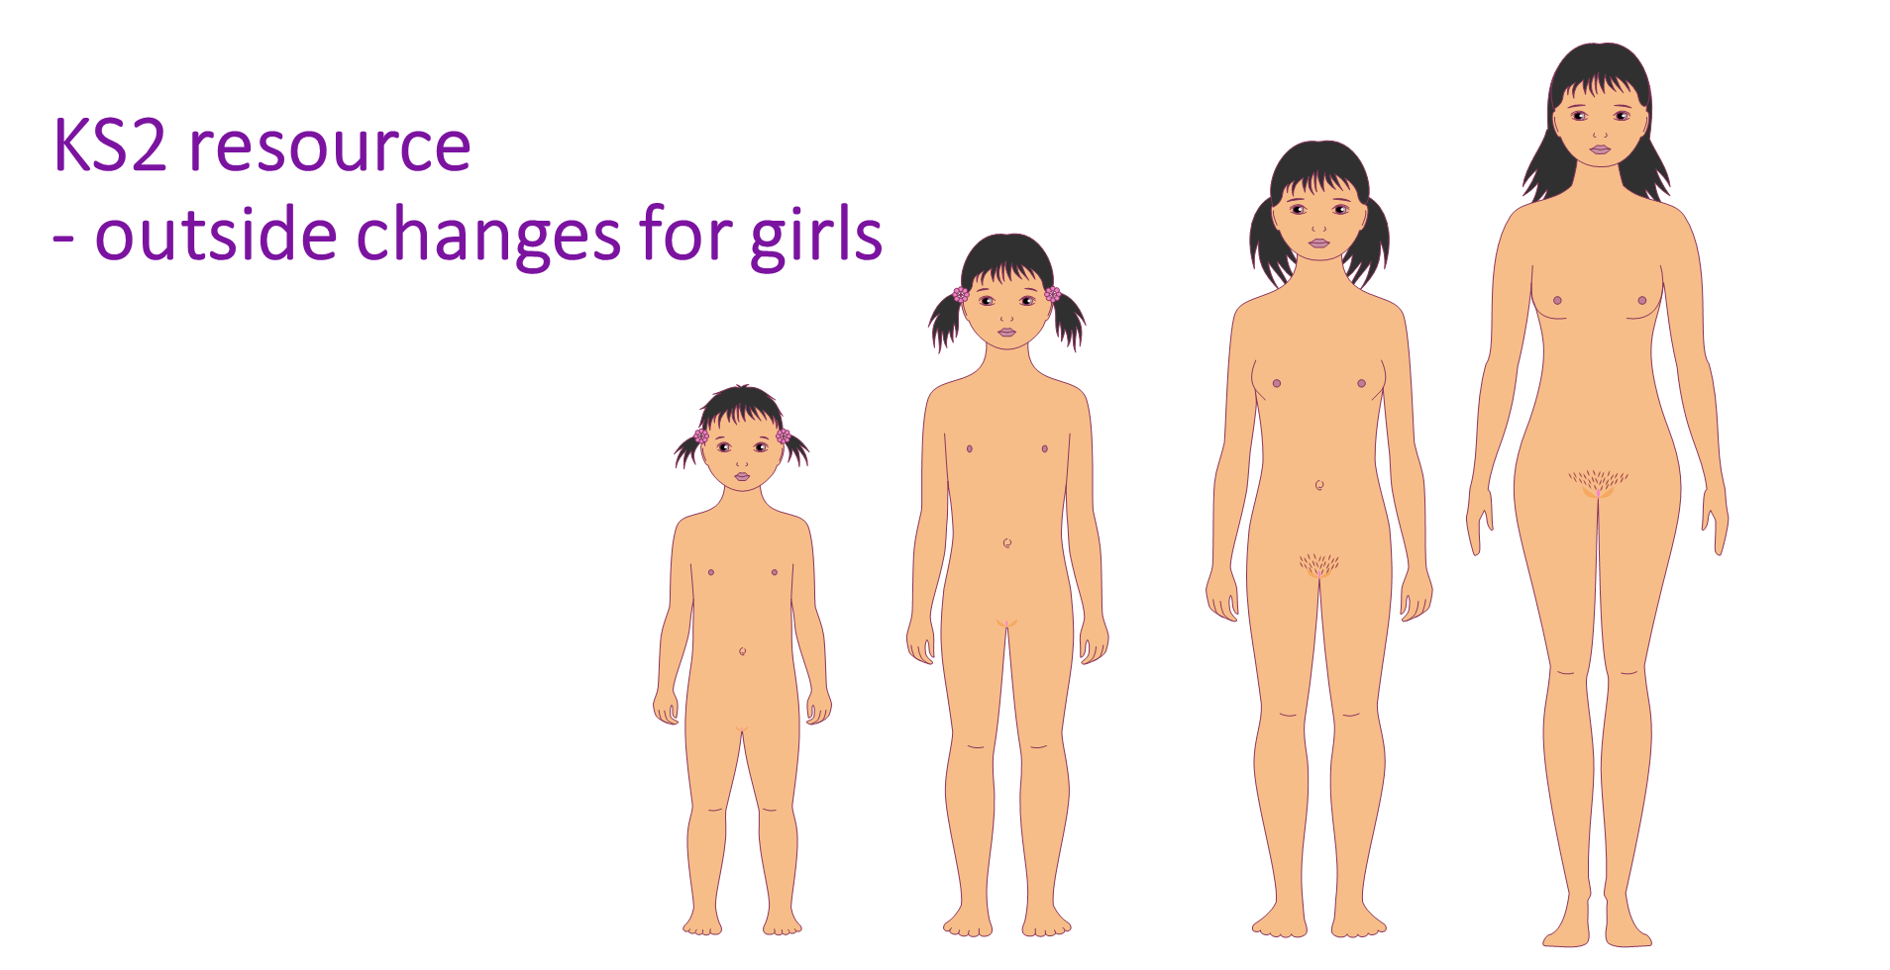

Slide 49
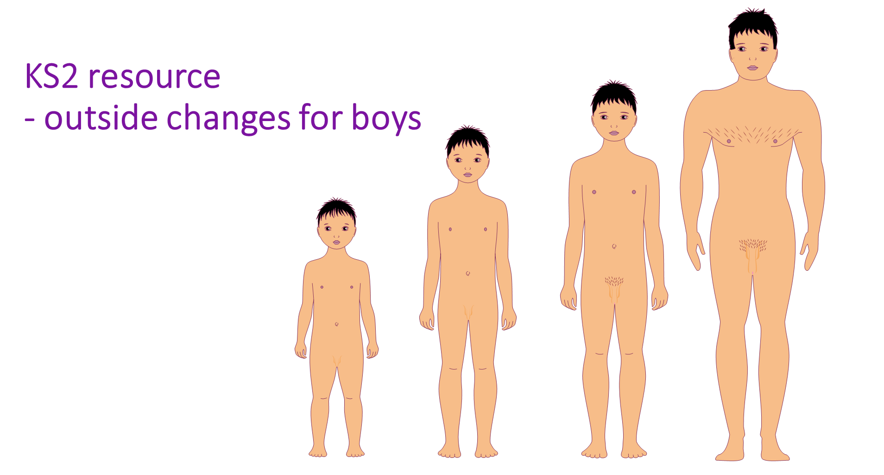

Slide 50
Example of one of the KS2 resources
- inside body changes for boys

Slide 51
Example of one of the KS2 resources
- inside body changes for girls

Slide 52
Example of a KS2 resource
- conception and childbirth

Slide 53
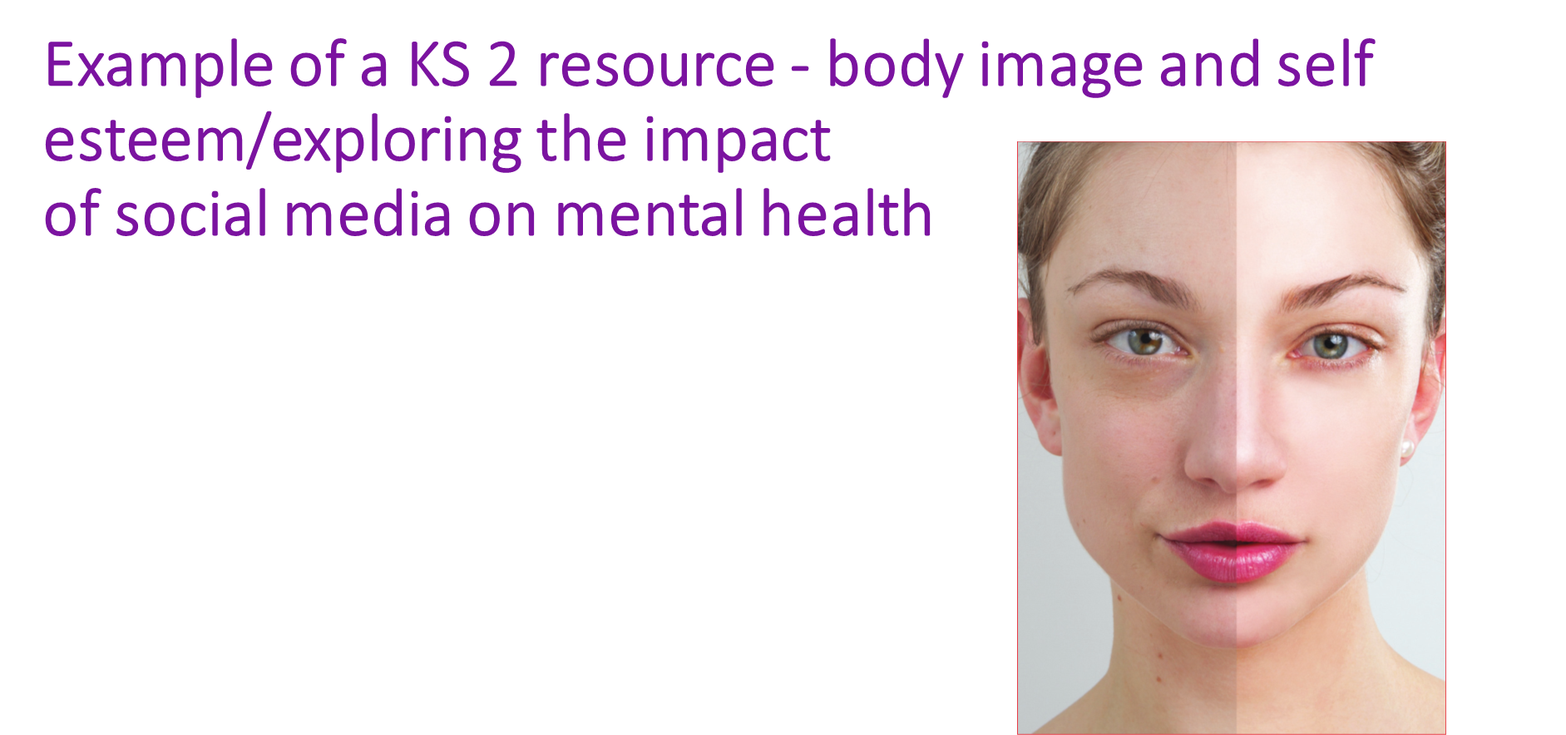

Slide 54
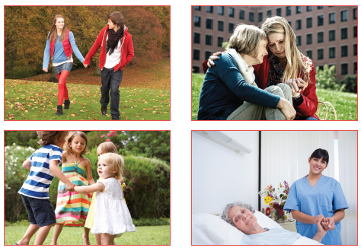
Example of a relationships resource for KS1

Slide 55
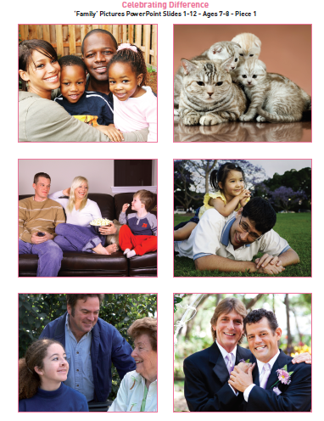
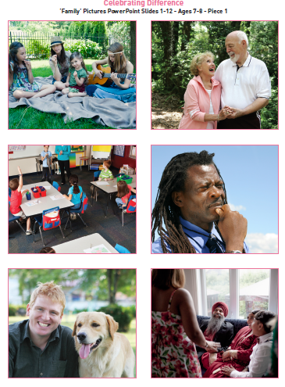
How Jigsaw teaches about different families in Y1

Slide 56
Thank you for taking the time to watch this powerpoint.
Any questions please email Miss Leaver via the office at admin@oswaldroad.manchester.sch.uk or you can attend our RSE workshop on 9.5.25 at 9am

